Slide 1
CONGESTION
Congestion in a network may occur if the load on the network (the number of packets sent to the network) is greater than the capacity of the network (the number of packets a network can handle)
Congestion control refers to the mechanisms and techniques to control the congestion and keep the load below the capacity.

Slide 2
Congestion Control Introduction:
When too many packets are present in (a part of) the subnet, performance degrades. This situation is called congestion.
As traffic increases too far, the routers are no longer able to cope and they begin losing packets.
At very high traffic, performance collapses completely and almost no packets are delivered.
Reasons of Congestion:
  Slow Processors.
  High stream of packets sent from one of the sender.
  Insufficient memory.
  High memory of Routers also add to congestion as becomes un manageable and un accessible. (Nagle, 1987).
  Low bandwidth lines.
Then what is congestion control? Congestion control has to do with making sure the subnet is able to carry the offered traffic.
Congestion control and flow control are often confused but both helps reduce congestion.

Slide 3
General Principles of Congestion Control
Three Step approach to apply congestion control:
Monitor the system .
  detect when and where congestion occurs.
Pass information to where action can be taken.
Adjust system operation to correct the problem.
How to monitor the subnet for congestion.
  percentage of all packets discarded for lack of buffer space,
  average queue lengths,
  number of packets that time out and are retransmitted,
  average packet delay
  standard deviation of packet delay (jitter Control).

Slide 4
Knowledge of congestion will cause the hosts to take appropriate action to reduce the congestion.
For a scheme to work correctly, the time scale must be adjusted carefully.
If every time two packets arrive in a row, a router yells STOP and every time a router is idle for 20 µsec, it yells GO, the system will oscillate wildly and never converge.
Dividing all algorithms into
  open loop or
  closed loop
They further divide the open loop algorithms into ones that act at the source versus ones that act at the destination.
The closed loop algorithms are also divided into two subcategories:
  explicit feedback implicit feedback.
  In explicit feedback algorithms, packets are sent back from the point of congestion to warn the source.
  In implicit algorithms, the source deduces the existence of congestion by making local observations, such as the time needed for acknowledgements to come back.
The presence of congestion means that the load is (temporarily) greater than the resources can handle.
Solution?
  increase the resources or
  decrease the load.
That is not always possible. So we have to apply some congestion prevention policy.

Slide 5

Queues in a router

Slide 6
CONGESTION CONTROL
Congestion control refers to techniques and mechanisms that can either prevent congestion, before it happens, or remove congestion, after it has happened.
In general, we can divide congestion control mechanisms into two broad categories: open-loop congestion control (prevention) and closed-loop congestion control (removal).
Topics discussed in this section:
Open-Loop Congestion Control
Closed-Loop Congestion Control

Slide 7

Congestion control categories

Slide 8
Warning Bit or Backpressure:
DECNET(Digital Equipment Corporation to connect mini computers) architecture signaled the warning state by setting a special bit in the packet's header.
The source then cut back on traffic.
The source monitored the fraction of acknowledgements with the bit set and adjusted its transmission rate accordingly.
As long as the warning bits continued to flow in, the source continued to decrease its transmission rate. When they slowed to a trickle, it increased its transmission rate.
Disadvantage: Note that since every router along the path could set the warning bit, traffic increased only when no router was in trouble.

Slide 9

Backpressure method for alleviating congestion
The backpressure technique can be applied only to virtual circuit networks

Slide 10
Choke Packets:
The router sends a choke packet back to the source host, giving it the destination found on the path.
The original packet is tagged (a header bit is turned on) so that it will not generate any more choke packets farther along the path and is then forwarded in the usual way.
When the source host gets the choke packet, it is required to reduce the traffic sent to the specified destination by X percent.
See next figure, flow starts reducing from step 5.
Reduction from 25% to 50% to 75% and so on.
Router maintains threshold. And based on it gives
  Mild Warning
  Stern Warning
  Ultimatum.
Variation: Use queue length or buffers instead of line utilization as trigger signal. This will reduce traffic. Chocks also increase traffic.

Slide 11

Choke packet

Slide 12
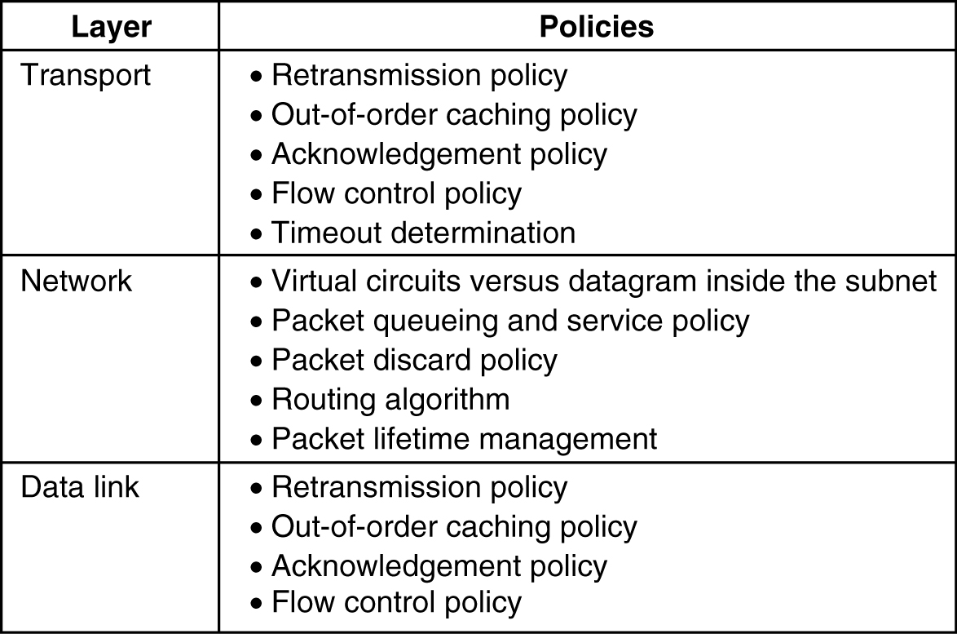
Congestion Prevention Policies
Policies that affect congestion.
5-26

Slide 13
Systems are designed to minimize congestion in the first place, rather than letting it happen and reacting after the fact.
Data Link Layer:
  The retransmission policy is concerned with how fast a sender times out and retransmits. A jumpy sender that times out quickly and retransmits all outstanding packets using go back n will put a heavier load on the system than will a leisurely sender that uses selective repeat.
  Out of order packets management depends upon buffering policy. If receivers routinely discard all out-of-order packets, these packets will have to be transmitted again later, creating extra load i.e prefer selective repeat instead of GoBackN.
  Acknowledgement packets generate extra traffic. Solution? Piggyback.
  Flow Control: Tight Flow and Loose Flow. Tight flow means smaller windows protocols, reduces data rate, helps fight congestion.
Notes:
By Bhargavi H Goswami, Email: bhargavigoswami@gmail.com, +91 9428156545

Slide 14
2. Network Layer:
  choice between using virtual circuits and using datagram's affects congestion since many congestion control algorithms work only with virtual-circuit subnets.
  Packet queuing and service policy relates to whether routers have one queue per input line, one queue per output line, or both. round robin or priority based?
  Discard policy is the rule telling which packet is dropped when there is no space.
  Routing policy we have already discussed a lot upon.
  Packet lifetime management deals with how long a packet may live before being discarded.
3. Transport Layer:
  Same issues occur as in the data link layer
  If the timeout interval is too short, extra packets will be sent unnecessarily. If it is too long, congestion will be reduced but the response time will suffer whenever a packet is lost.

Slide 15
QUALITY OF SERVICE
Quality of service (QoS) is an internetworking issue that has been discussed more than defined. We can informally define quality of service as something a flow seeks to attain.
Topics discussed in this section:
Flow Characteristics
Flow Classes

Slide 16

Flow characteristics

Slide 17
TECHNIQUES TO IMPROVE QoS
In this section, we discuss some techniques that can be used to improve the quality of service. We briefly discuss four common methods: scheduling, traffic shaping, admission control, and resource reservation.
Topics discussed in this section:
Scheduling
Traffic Shaping
Resource Reservation
Admission Control

Slide 18
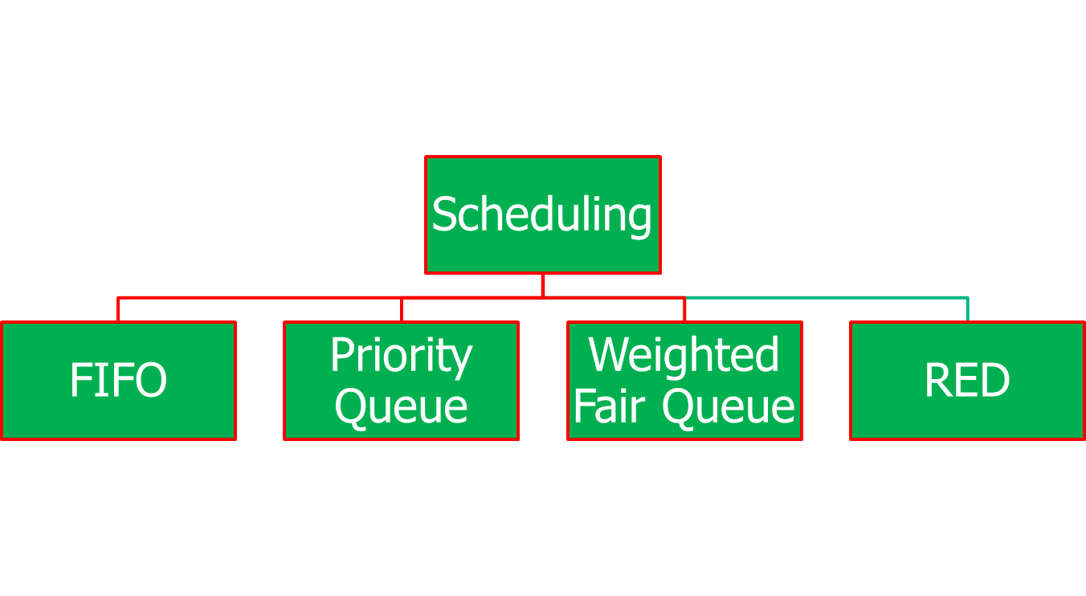
Scheduling

Slide 19

FIFO queue

Slide 20

Priority queuing

Slide 21

Weighted fair queuing

Slide 22
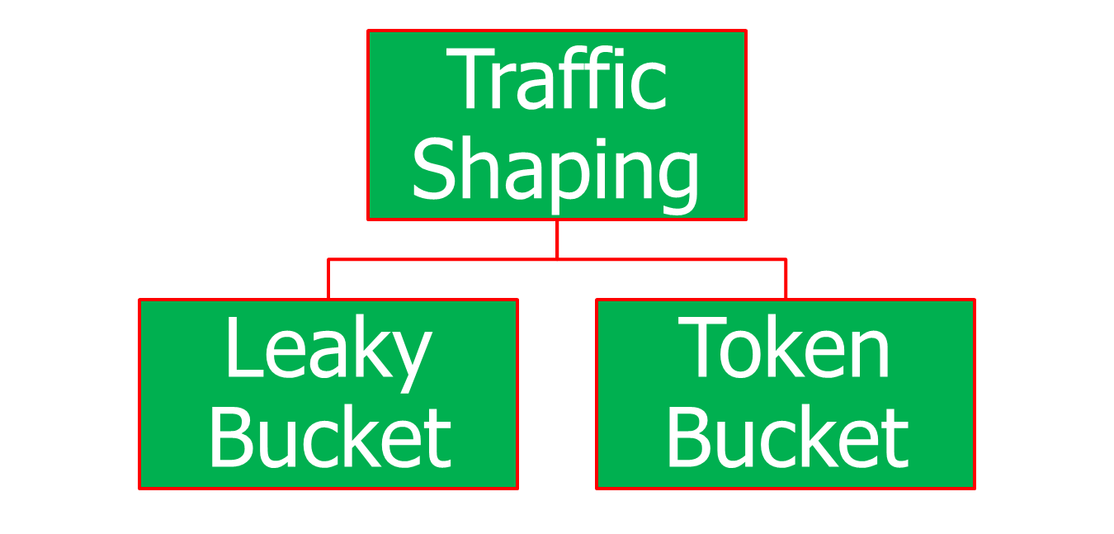
Traffic Shaping

Slide 23

Leaky bucket

Slide 24

Leaky bucket implementation

Slide 25

Note
A leaky bucket algorithm shapes bursty traffic into fixed-rate traffic by averaging the data rate. It may drop the packets if the bucket is full.

Slide 26
Note
The token bucket allows bursty traffic at a regulated maximum rate.

Slide 27

Token bucket

Slide 28
Resource Reservation and Admission Control
Buffer, CPU Time, Bandwidth are the resources that can be reserved for particular flows for particular time to maintain the QoS.
Mechanism used by routers to accept or reject flows based on flow specifications is what we call Admission Control.

